Slide 1
TA info
https://docs.google.com/document/d/1PcBq_UUvQaco0aRjajeMxw0UJpHm8yF3U7m8iBF7HyQ/edit?usp=sharing

Slide 2

CSC 2302/DSCI 1302 Object Oriented Programming (cont.)
- S M Towhidul Islam

Slide 3
Recap
Class attribute
Class
Instance attribute
Constructor
class Car: make = 'Toyota' def __init__(self, model, trim='LE'): self.model = model self.trim = trim
def print_model(self):
print(self.model) car1 = Car('Camry') car2 = Car('Corolla', 'XLE’)
print(car1.make)
Instantiation
Default Params
Instance/
Objects
Instance Methods
Member operator / dot notation

Slide 4
Class Diagram Example
Class name
Seat
-seat_num -name -paid
+reserve() +cancel_reservation() +is_available() +print_info()
Data attributes
Instance methods
Note:
Member access
Private
+ Public
UML Class Diagram
http://en.wikipedia.org/wiki/Unified_Modeling_Language

Slide 5
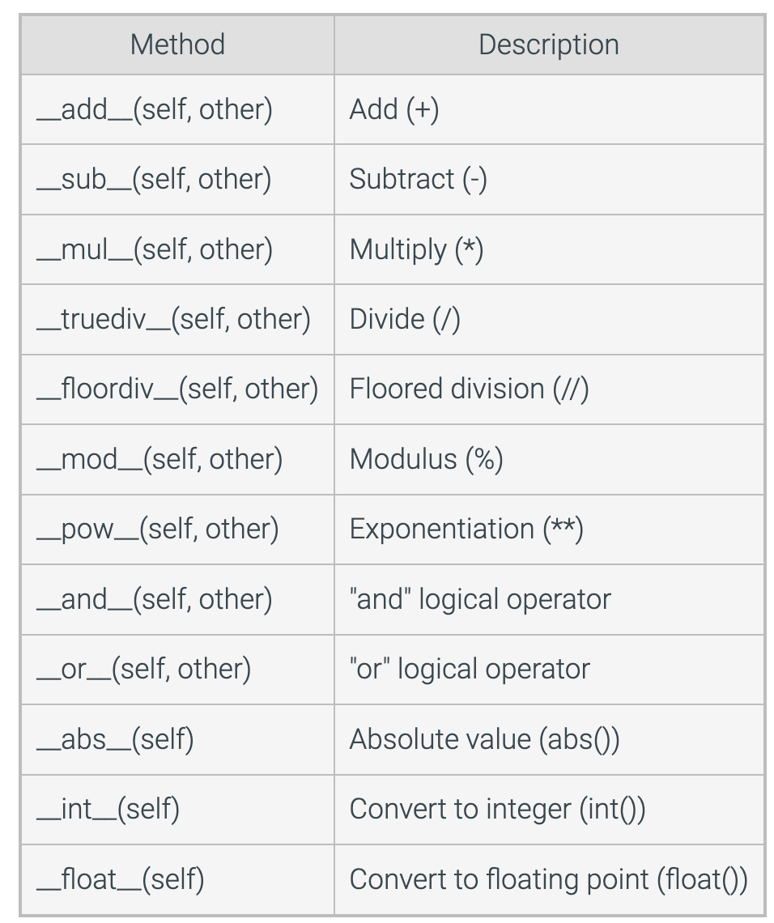
Classes as numeric types
Numeric operators such as +, -, *, and / can be overloaded using class customization techniques
A user-defined class can be treated as a numeric object in which instances of that class can be added , multiplied, etc.
Methods for emulating numeric types

Slide 6
class Point: def __init__(self,x,y): self.x = x self.y = y def __add__(self, other): #overloaded + operator return Point(self.x+other.x,self.y+other.y) def __sub__(self, other): #overloaded - operator return Point(self.x-other.x,self.y-other.y) def __str__(self): return f"({self.x},{self.y})" #driver code point1 = Point(1,2) point2 = Point(-2, 0) point3 = point1 + point2 point4 = point1-point2 print(point3) print(point4)

Slide 7
Suggested Reading (ZyBook):
9.9 Classes as Numeric Types

Slide 8
Inheritance
A fundamental concept in OOP
Inheritance allows us to create a new class from an existing class.
The new class inherits the attributes and methods of the existing class
Helps to create a hierarchy of classes – model complex relationship in software systems
Advantage – code reusability, modularity, efficiency and many more

Slide 9
The new class that is created is known as subclass (child or derived class) and the existing class from which the child class is derived is known as superclass (parent or base class).
class SuperClass:
…
class SubClass(SuperClass):
…

Slide 10
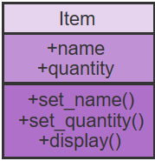
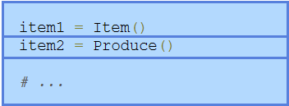
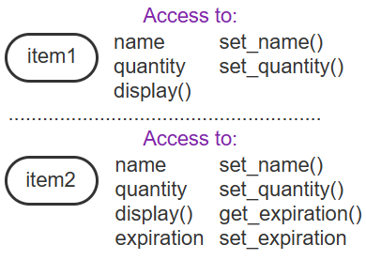
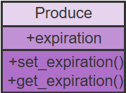
Inheritance
- The inheritance relationship is commonly drawn using class diagrams
- A class diagram depicts a class' name, data members, and methods
http://en.wikipedia.org/wiki/Unified_Modeling_Language

Slide 11
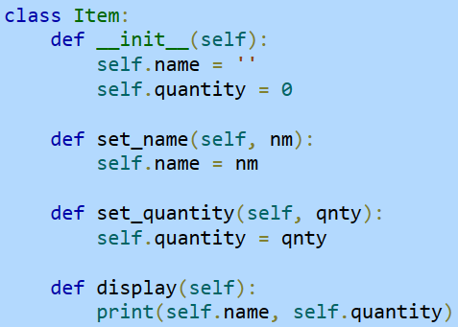
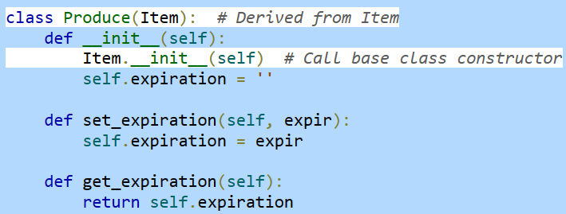
Inheritance

Slide 12
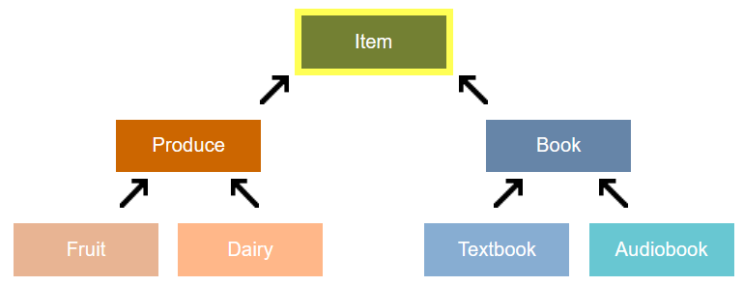
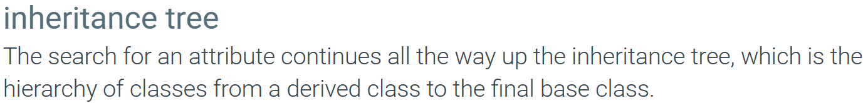
Inheritance tree example
A store inventory system

Slide 13
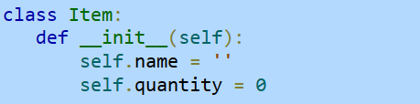
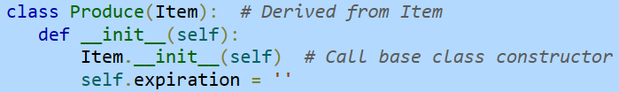


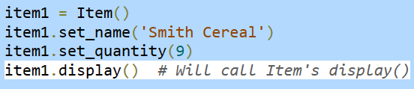
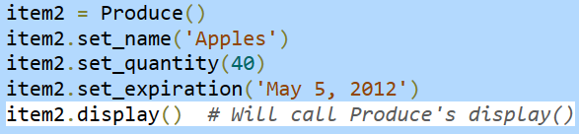
Overriding class methods
A member function of base class can redefine the method of the base class

Slide 14
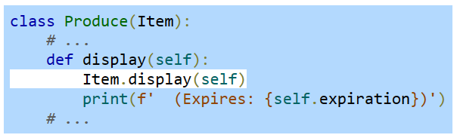
Overriding class methods
If needed, the derived class method can call the base class method

Slide 15
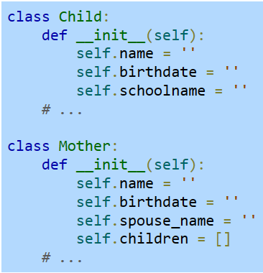
Is-a vs Has-a relationship
The concept of inheritance is often confused with composition
Composition is the idea that one object may be made up of other objects
Mother class : Has-a relationship with child class
Doesn’t involve inheritance

Slide 16
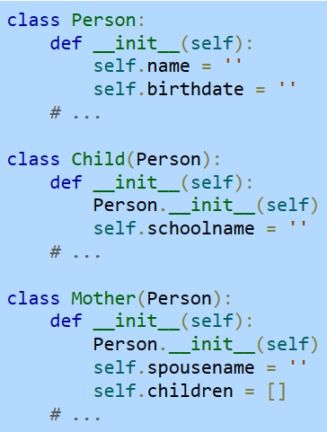
Is-a vs Has-a relationship
A programmer may note that a mother and a child are both a kind of person
So, the programmer may decide to better organize the program by defining a Person class
The Child and Mother classes have “is-a” relationship with Person class

Slide 17
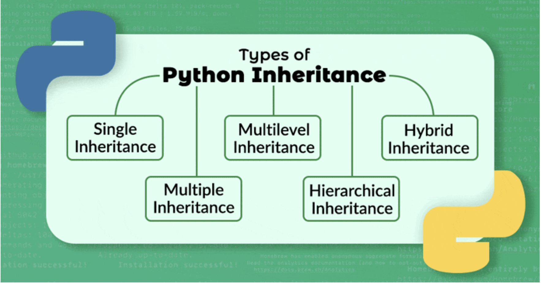

Slide 18
Single
Inheritance

Slide 19
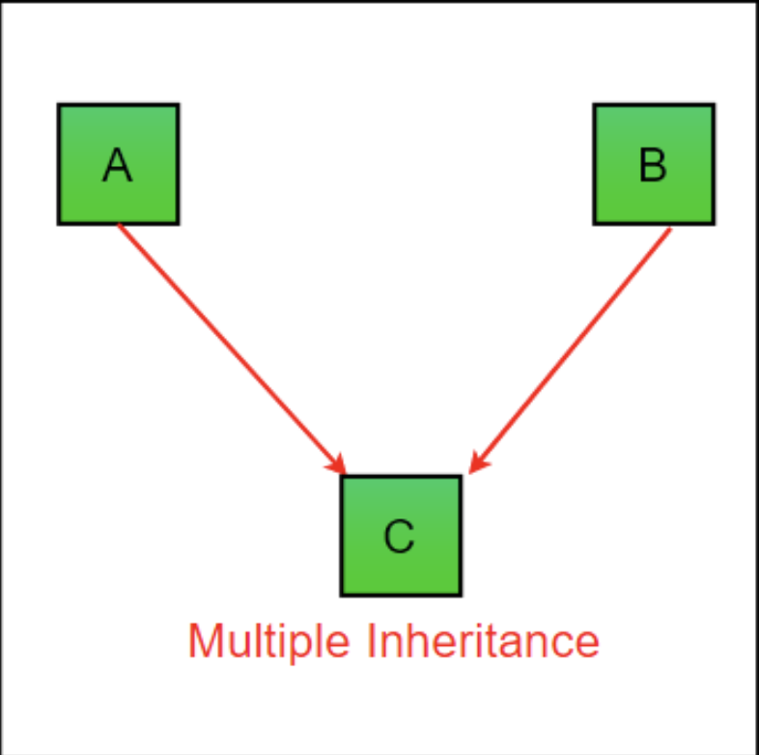
Multiple Inheritance
A class can be derived from more than one superclass in Python.
class SuperClass1: # features of SuperClass1 class SuperClass2: # features of SuperClass2 class MultiDerived(SuperClass1, SuperClass2): # features of SuperClass1 + SuperClass2 + MultiDerived class

Slide 20
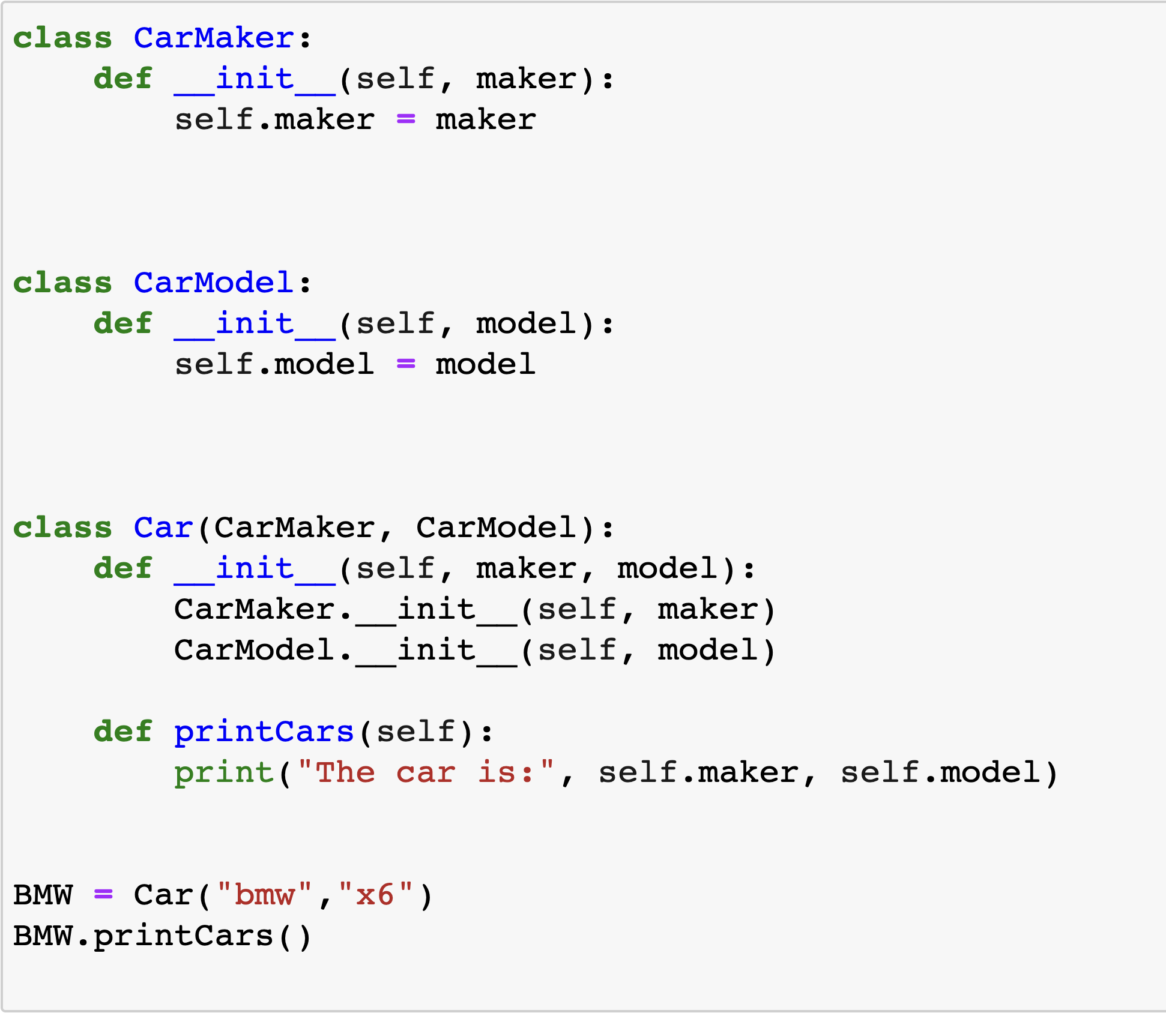

Slide 21
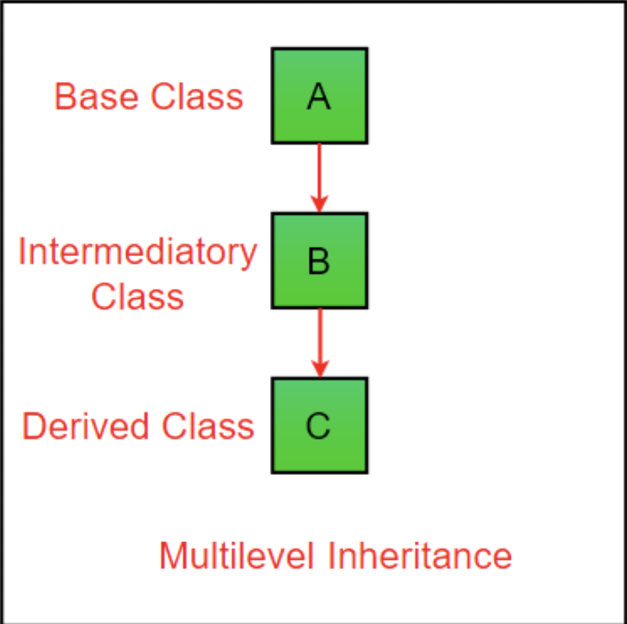
MultiLevel Inheritance
In Python, not only can we derive a class from the superclass but you can also derive a class from the derived class.
This form of inheritance is known as multilevel inheritance.
class SuperClass: # Super class code here class DerivedClass1(SuperClass): # Derived class 1 code here class DerivedClass2(DerivedClass1): # Derived class 2 code here
Notes:
Here, the DerivedClass1 class is derived from the SuperClass class, and the DerivedClass2 class is derived from the DerivedClass1 class.

Slide 22
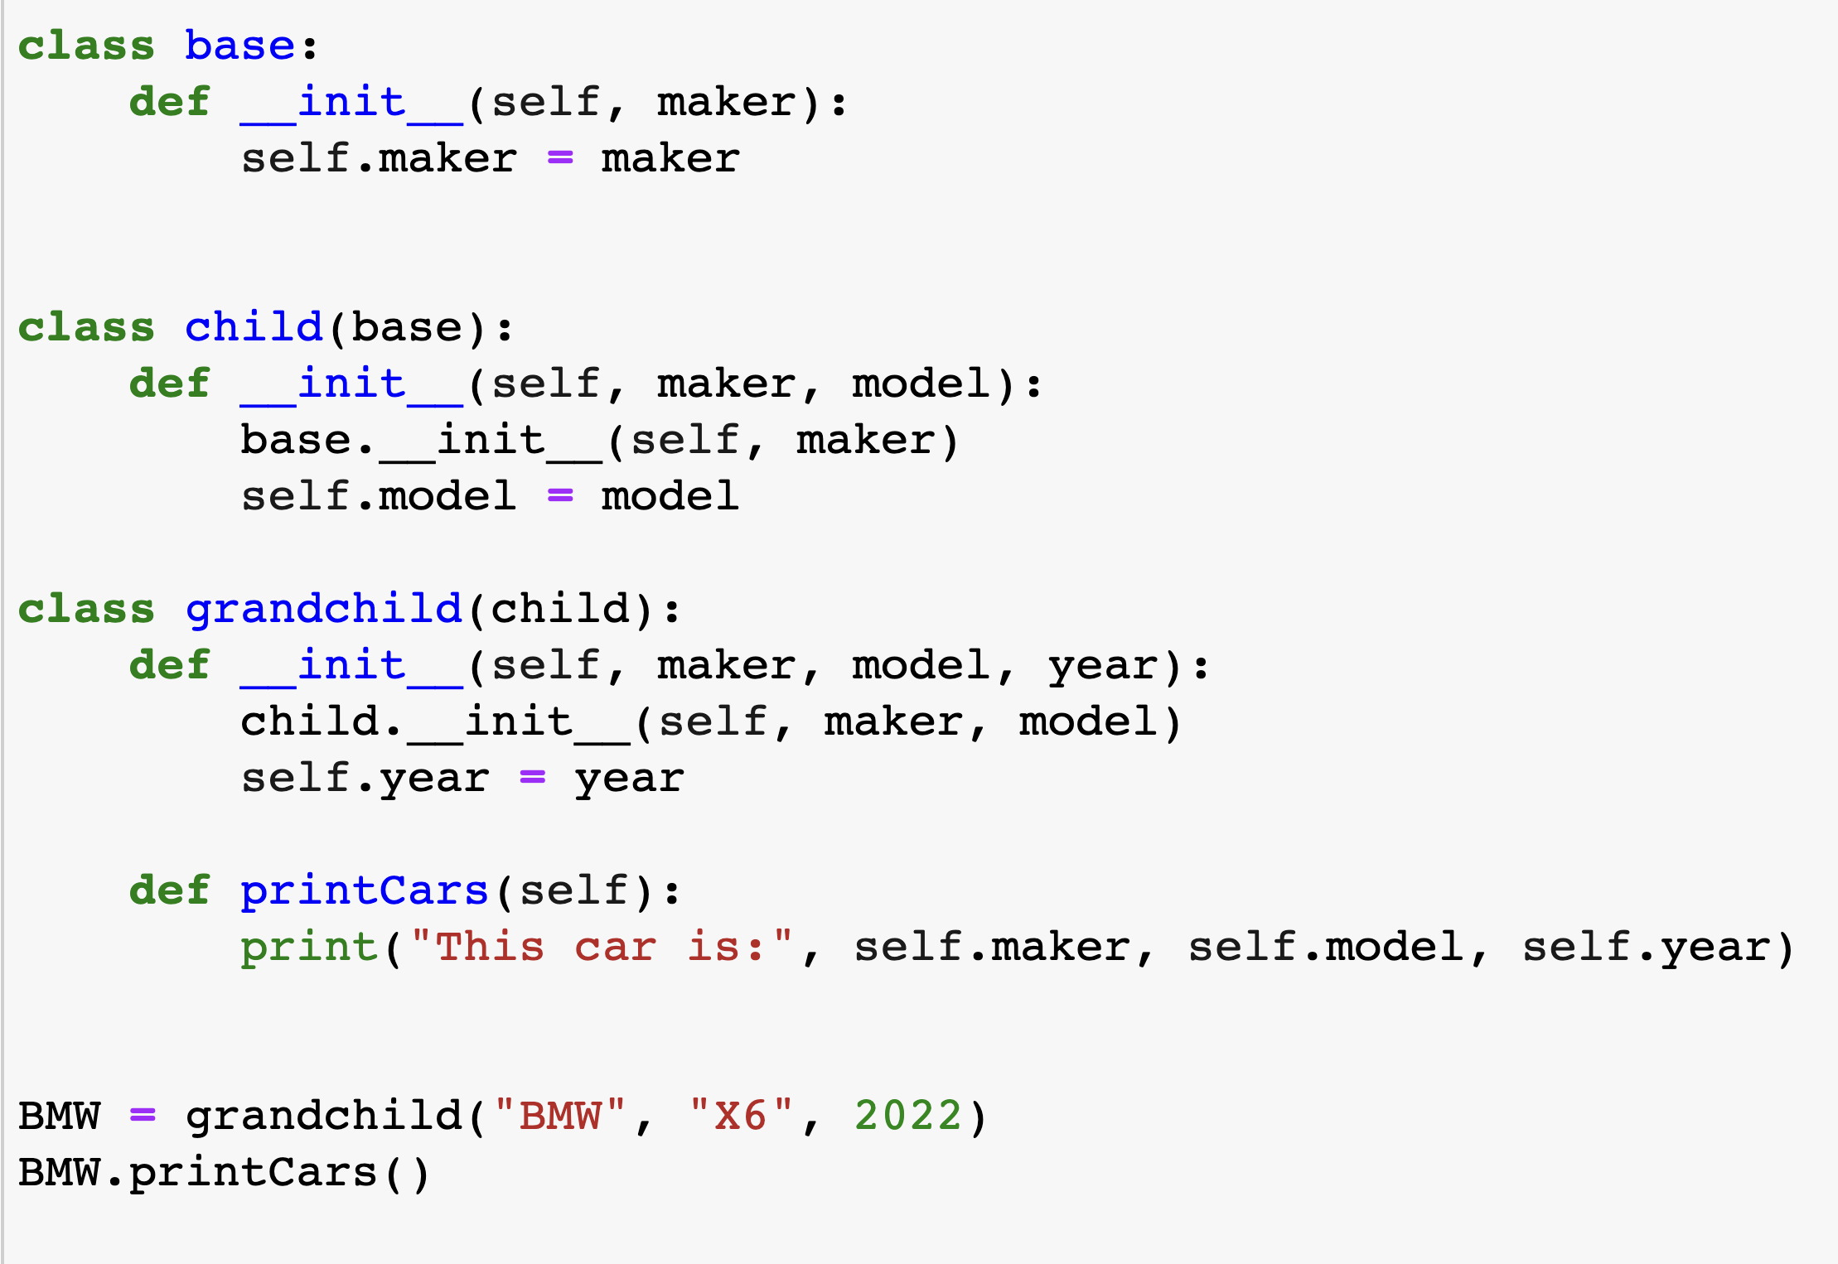

Slide 23
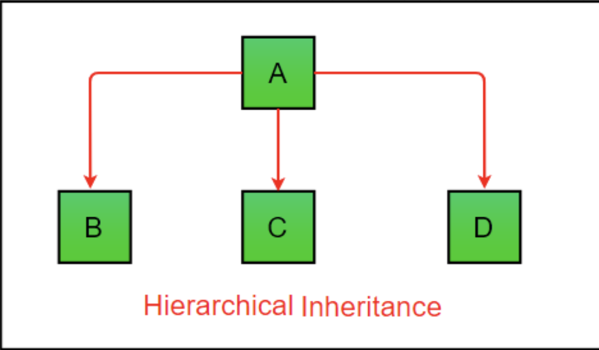
Hierarchical Inheritance
When more than one derived class are created from a single base, this type of inheritance is called hierarchical inheritance.
Hybrid Inheritance
Multiple types of inheritances
Notes:
we have a parent (base) class and two child (derived) classes.

Slide 24
Method Resolution Order (MRO) in Python
Hybrid Inheritance
A
Hierarchical Inheritance
print()
B
C
print()
Multiple Inheritance
D
d = D()
d.print()
Which version of the print() method will be called?
Diamond Problem!

Slide 25
Method Resolution Order (MRO)
If two super classes have the same method name and the derived class calls that method, Python uses the MRO to search for the right method to call.
class SuperClass1: def info(self): print("Super Class 1 method called") class SuperClass2: def info(self): print("Super Class 2 method called") class Derived(SuperClass1, SuperClass2): pass d1 = Derived() d1.info() # Output: "Super Class 1 method called"

Slide 26
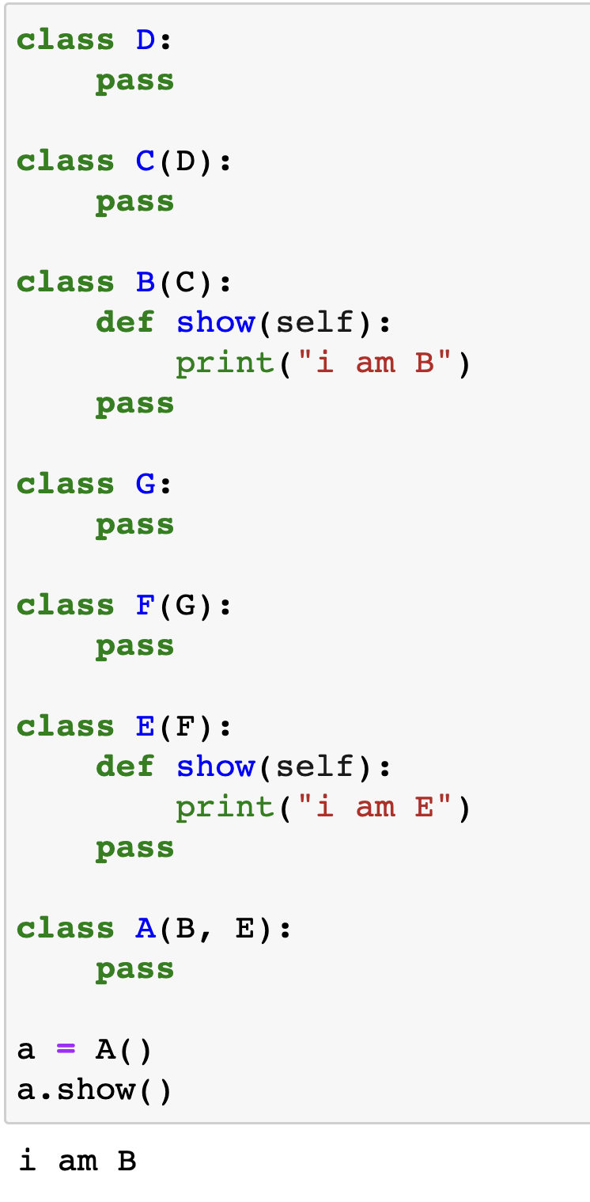
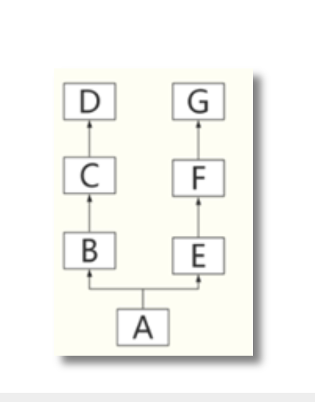

Slide 27
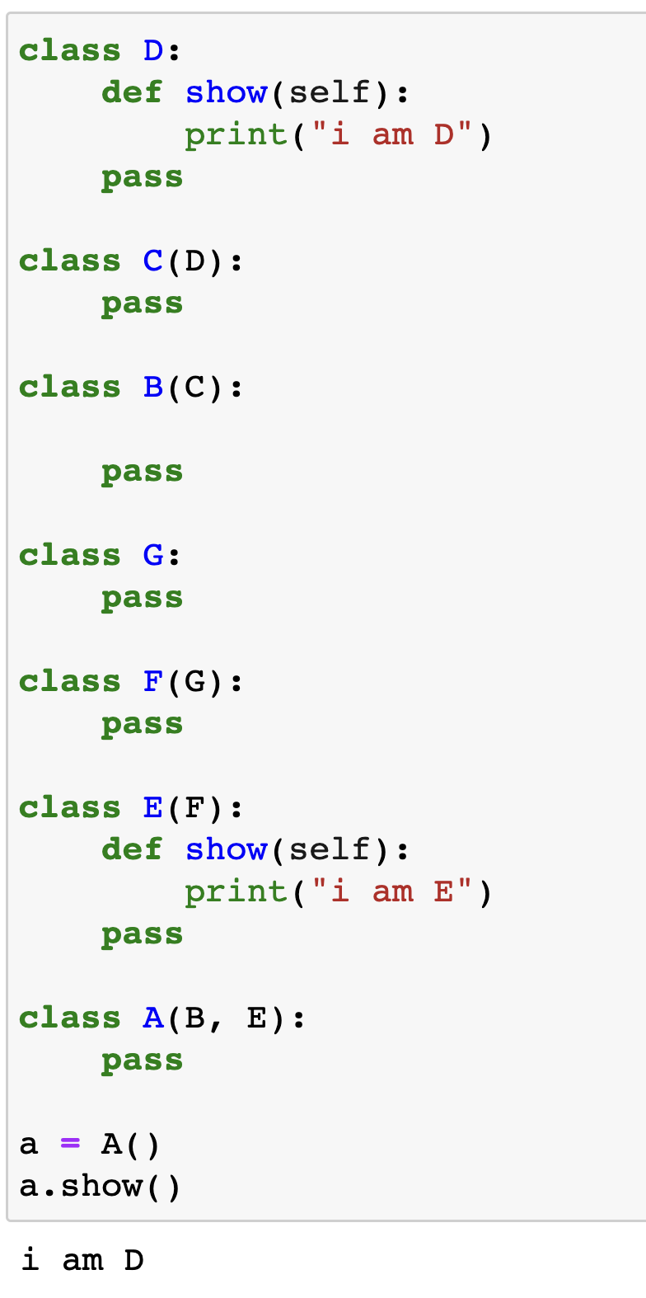
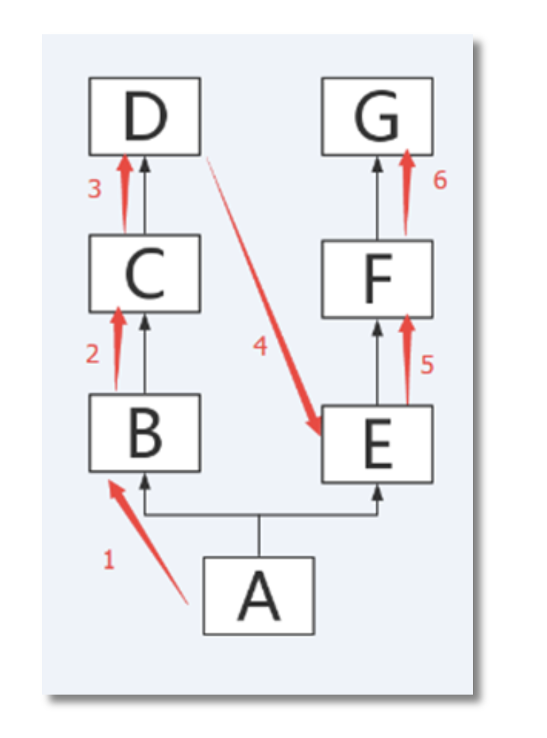

Slide 28
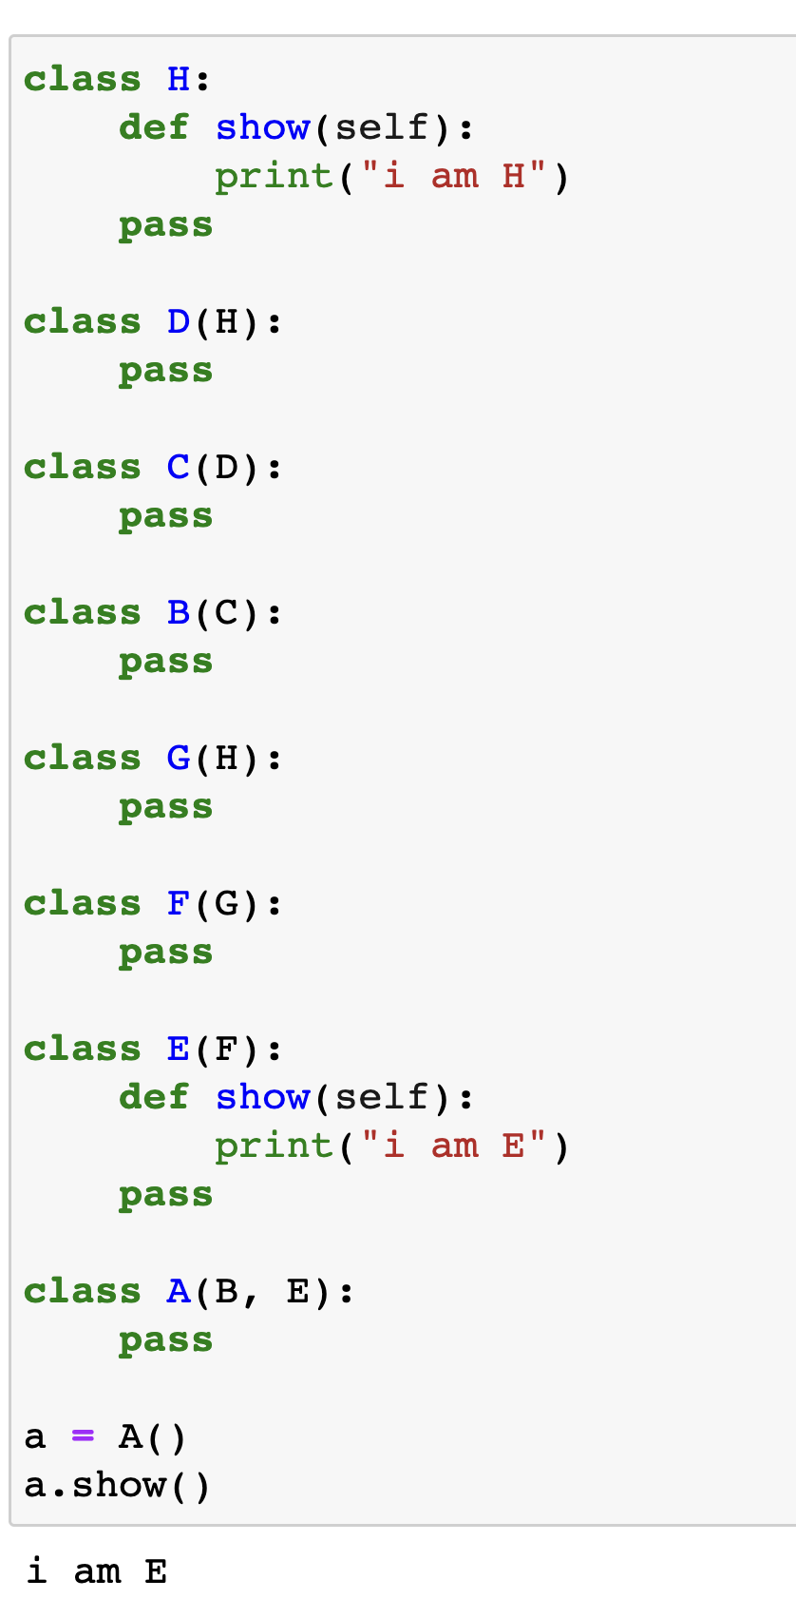
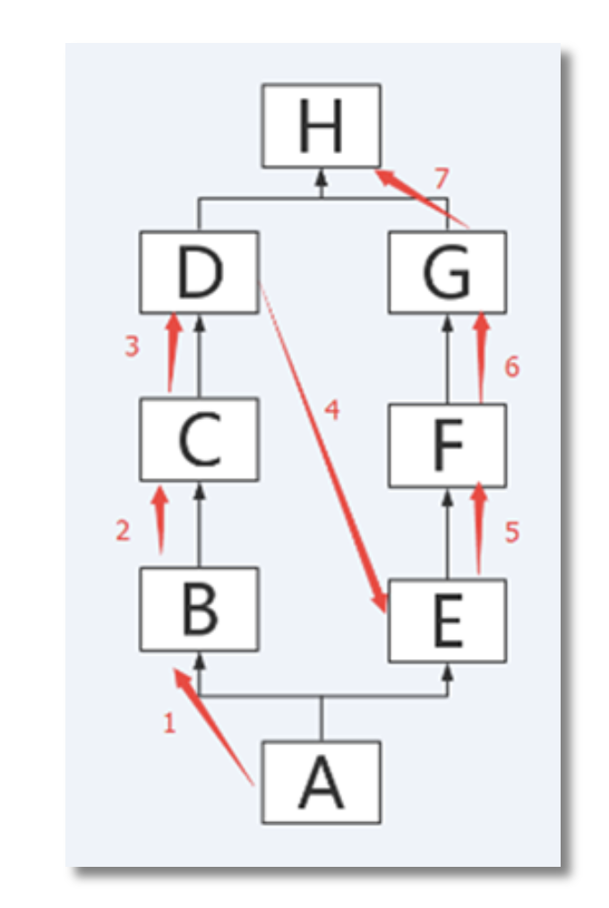

Slide 29
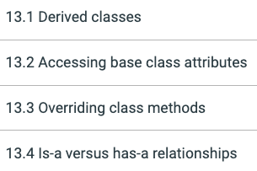
Suggested Reading (ZyBook)

